Slide 1
IMBALANCED BANKING DATASET
Exploring the challenges and solutions in dealing with imbalanced banking datasets.
MANASHWY PADHI (2348528)
BAMMIDI ABHINAV (2348508) NANDITHA.S (2348536)
Department of Computer Science)
Christ (Deemed-to-be-University
Banglore, India

Slide 2
Scaling and Distributing
To ensure uniformity, we will scale the columns representing Time and Amount along with the other columns. Additionally, we will create a sub-sample of the dataframe that includes an equal number of Fraud and Non-Fraud cases. This balanced approach will assist our algorithms in effectively identifying patterns that determine the fraudulent nature of a transaction
Subsample will be a dataframe with a 50/50 ratio of fraud and non-fraud transactions.
Issues of using original dataframe:
Overfitting: Our classification models will assume that in most cases there are no frauds! What we want for our model is to be certain when a fraud occurs.
Wrong Correlations: Although we don't know what the "V" features stand for, it will be useful to understand how each of this features influence the result (Fraud or No Fraud) by having an imbalance dataframe we are not able to see the true correlations between the class and features.

Slide 3
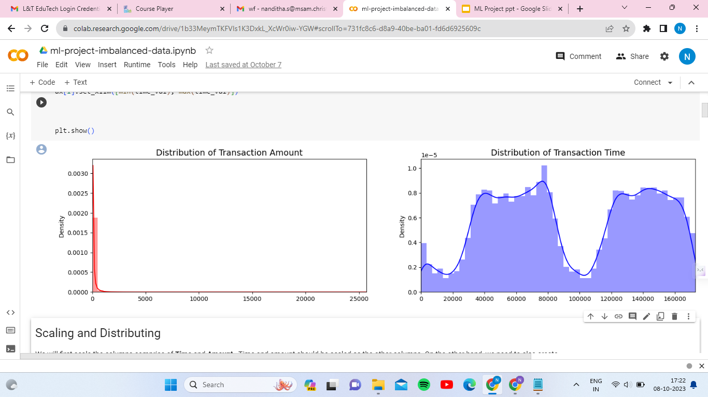
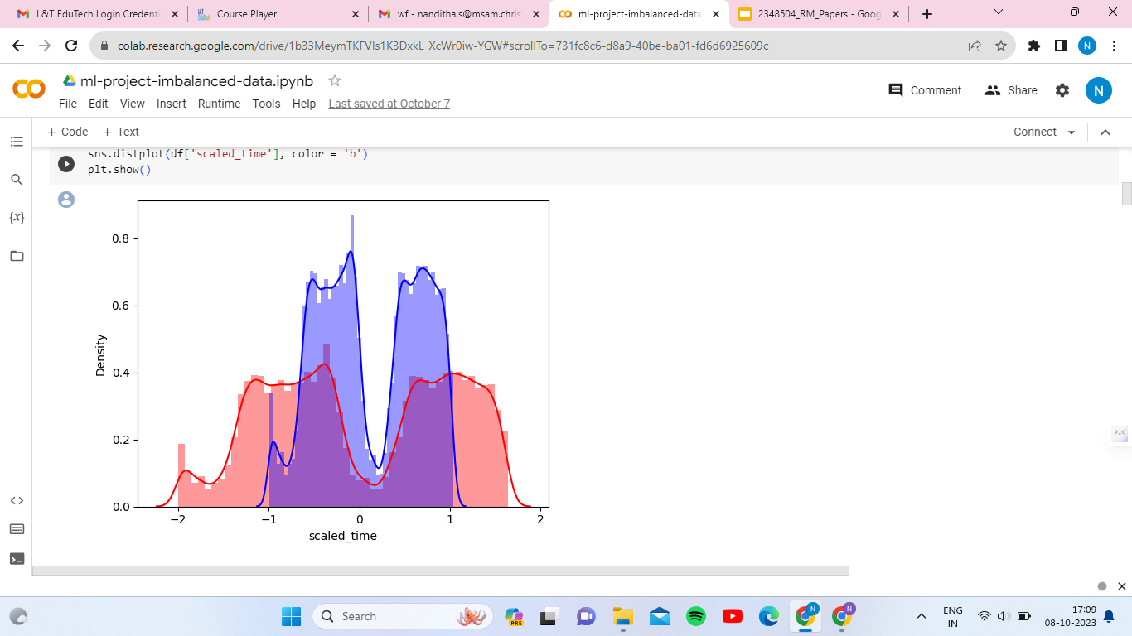
Scaled amount and scaled time are the columns with scaled values.
There are 492 cases of fraud in the dataset so that can randomly get 492 cases of non-fraud to create our new sub dataframe.
We concat the 492 cases of fraud and non fraud, creating a new sub-sample.

Slide 4
Why Robust Scaler is good?
The Robust Scaler uses the interquartile range (IQR) as a robust statistical measure. It scales the data based on the IQR, minimizing sensitivity to outliers.
To achieve robustness, the Robust Scaler subtracts the median (a robust measure of central tendency) and divides by the IQR. This normalization process ensures that extreme values have less influence on the scaled data.
By effectively reducing the impact of outliers, the Robust Scaler provides more reliable scaling for analysis and modeling purposes.
The Robust Scaler is less affected by outliers, uses the IQR for scaling, subtracts the median, and divides by the IQR, resulting in less distortion of extreme values and improved suitability for analysis and modeling.
X_{scaled} = {X - X_{median}}
{IQR}

Slide 5
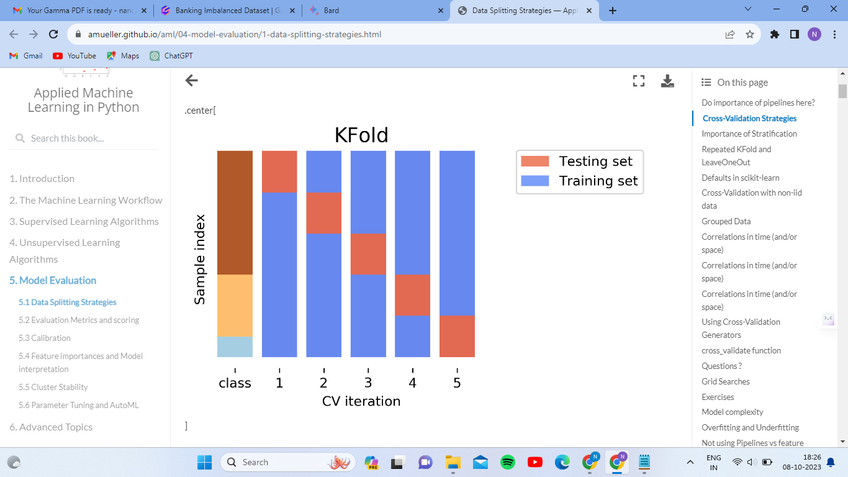
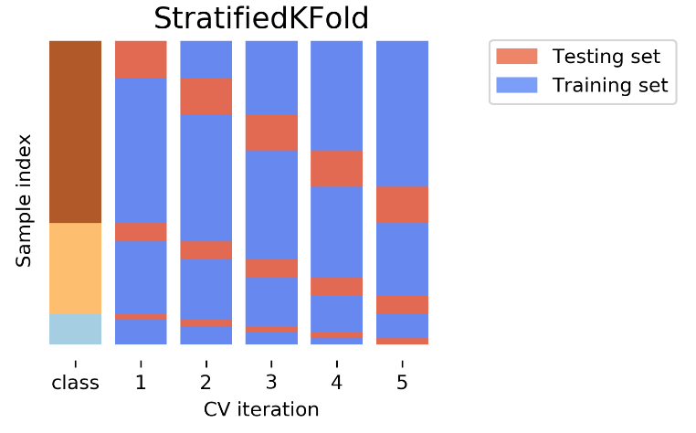
Splitting the Data
K-fold cross-validation is a technique used for model evaluation and selection. It involves dividing the dataset into k subsets or folds of roughly equal size. The process then iterates k times, with each fold being used as a validation set while the remaining k-1 folds are used for training the model.
Stratified k-fold ensures that each fold maintains the same class distribution as the original dataset, reducing the risk of biased evaluation results. K-fold divides the dataset into k subsets for training and validation, while stratified k-fold maintains the class distribution in each fold, making it suitable for imbalanced datasets.

Slide 6
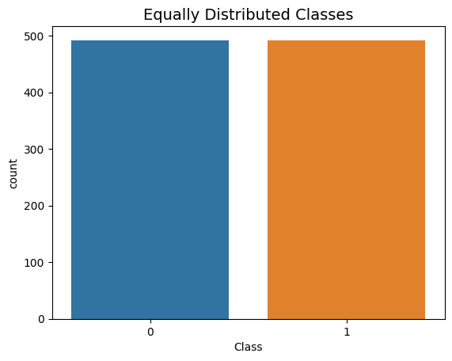
Random Under-Sampling:
Consists of removing data in order to have a more balanced dataset and thus, avoid our models from getting overfitting.
Find out how imbalanced our dataset is and then bring the non-fraud transactions to the same amount as fraud transactions, 492 in this case.
As we can see from the graph, both the classes are balanced after applying Random Under-Sampling

Slide 7
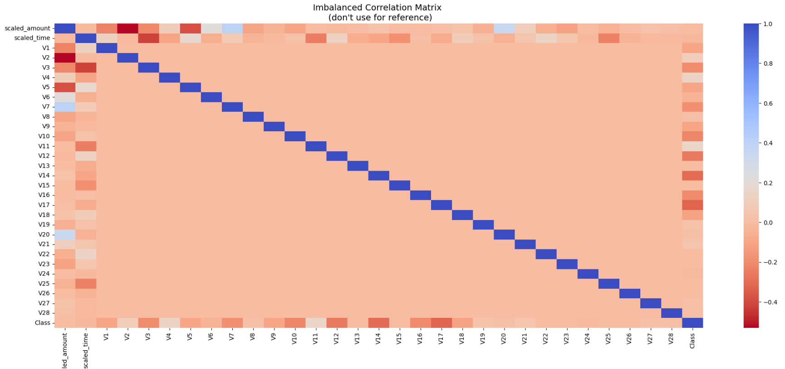
Correlation Matrices
Correlation matrices are the essence of understanding our data.
We want to know if there are features that heavily influence in whether a specific transaction is fraudulent or not.
It is very important that we use the correct data frame, in this case the sub-samples in order to see which features have high positive or negative correlation with regards to fraudulent transactions.

Slide 8
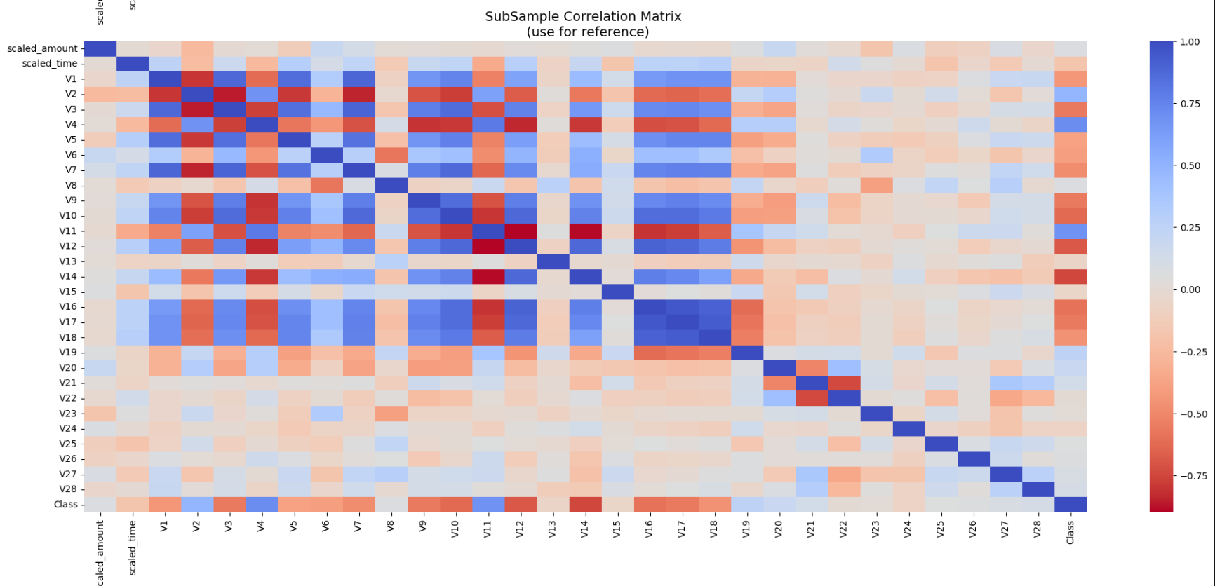
As we can see, there are only a few features that are correlated to in the imbalanced dataset, and the heatmap is effectively empty.
It is evident from this heatmap that there is a lot of correlation. We are effectively looking for regions that are ‘blue’ which signifies the correlation (1.0)

Slide 9
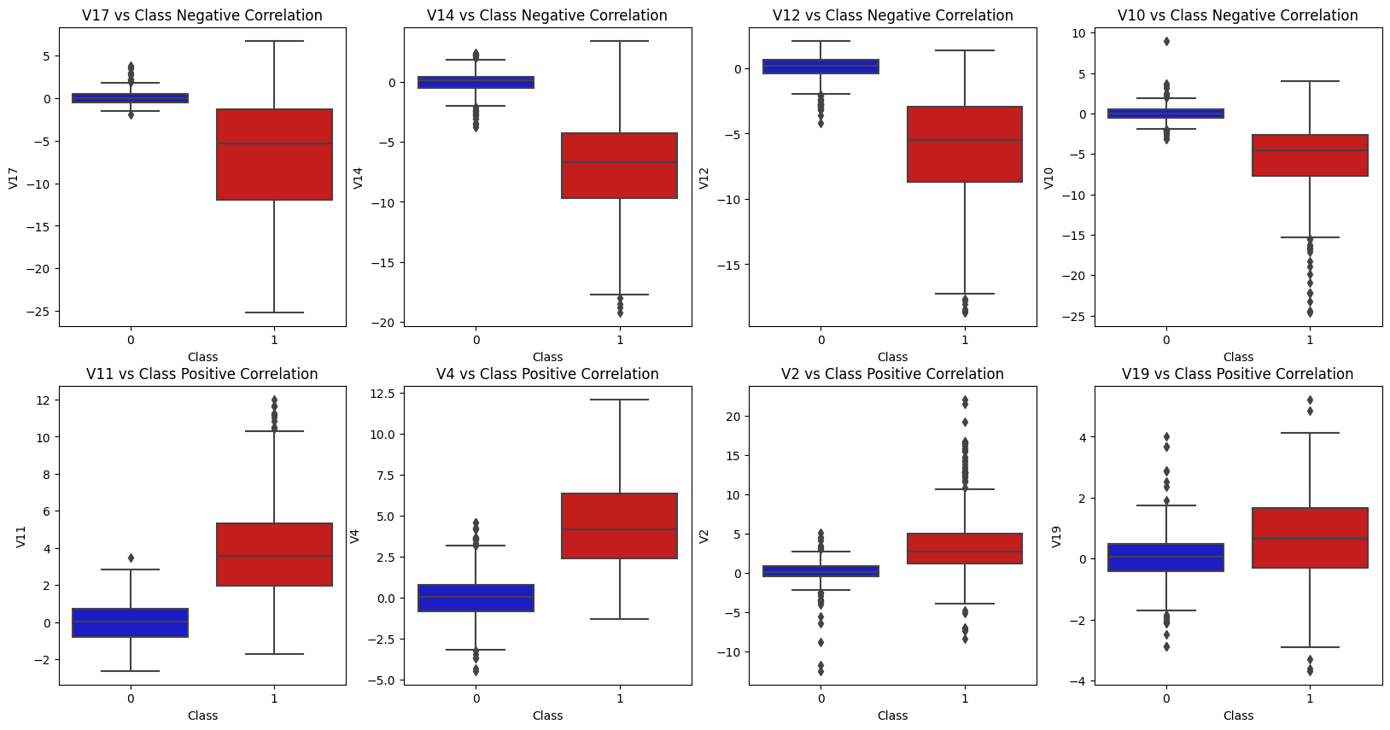
Summary:
Negative Correlation: V17, V14, V12, an V10 are negatively correlated.
Positive Correlation: V2, V4, V11, and V19 are positively correlated.

Slide 10
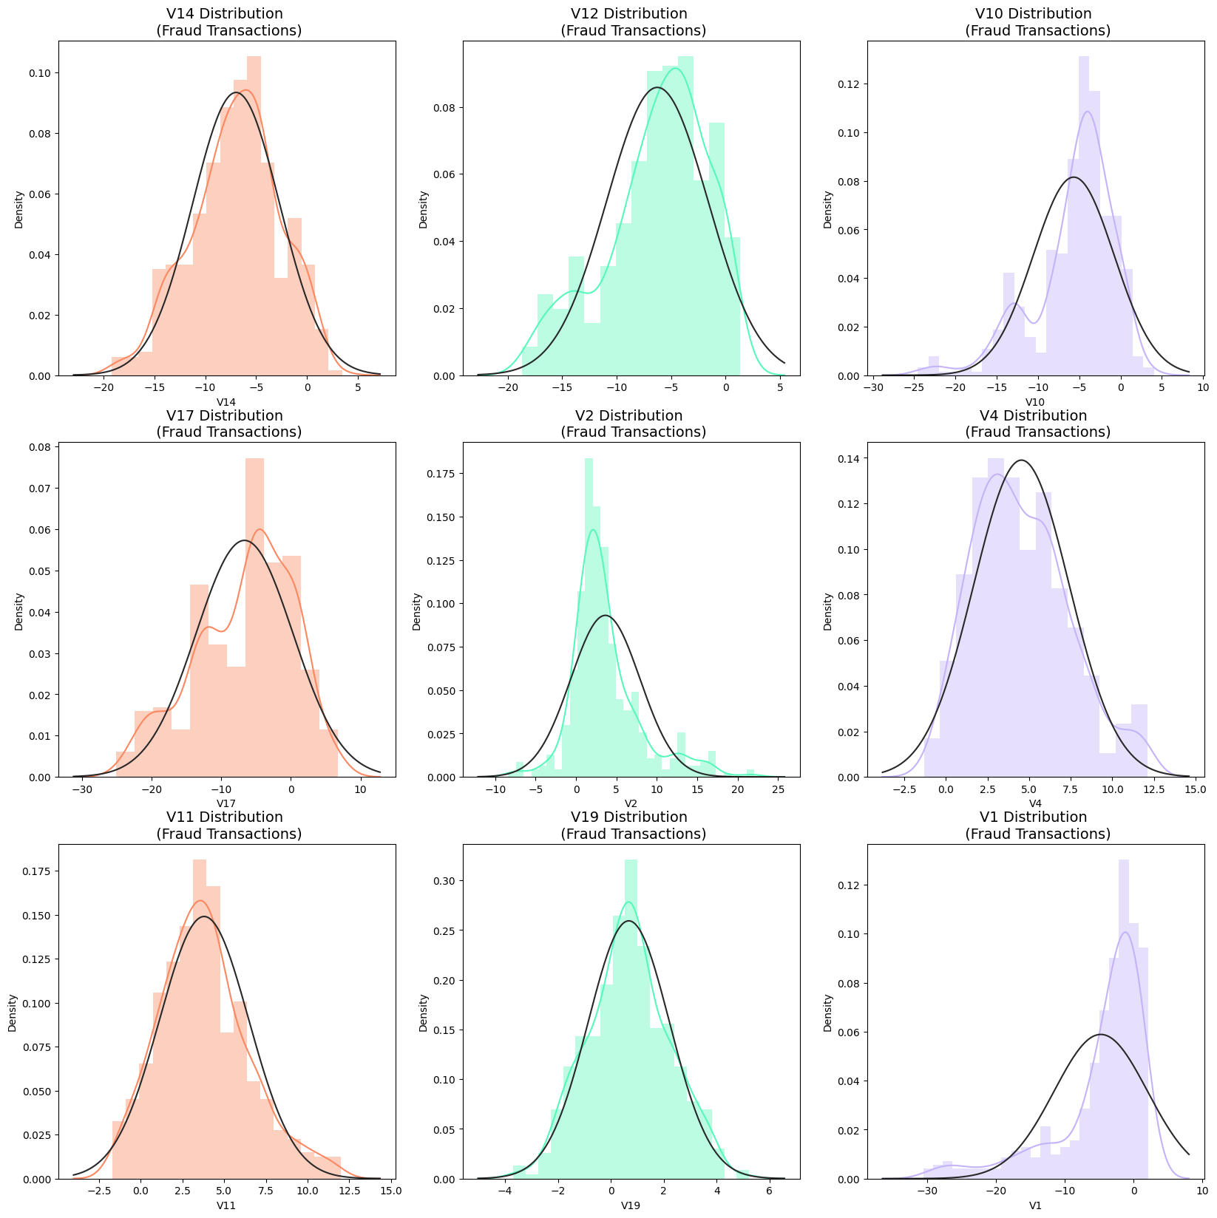
Anomaly Detection : Main aim is to remove “extreme outliers” from features that have a high correlation within our classes. This will have a positive impact on the accuracy of out models.
IQR: We calculate this by the difference between 75th and 25th percentiles. We create a threshold beyond the 75th and 25th percentile that in case some instance pass this threshold, the instance will be deleted.

Slide 11
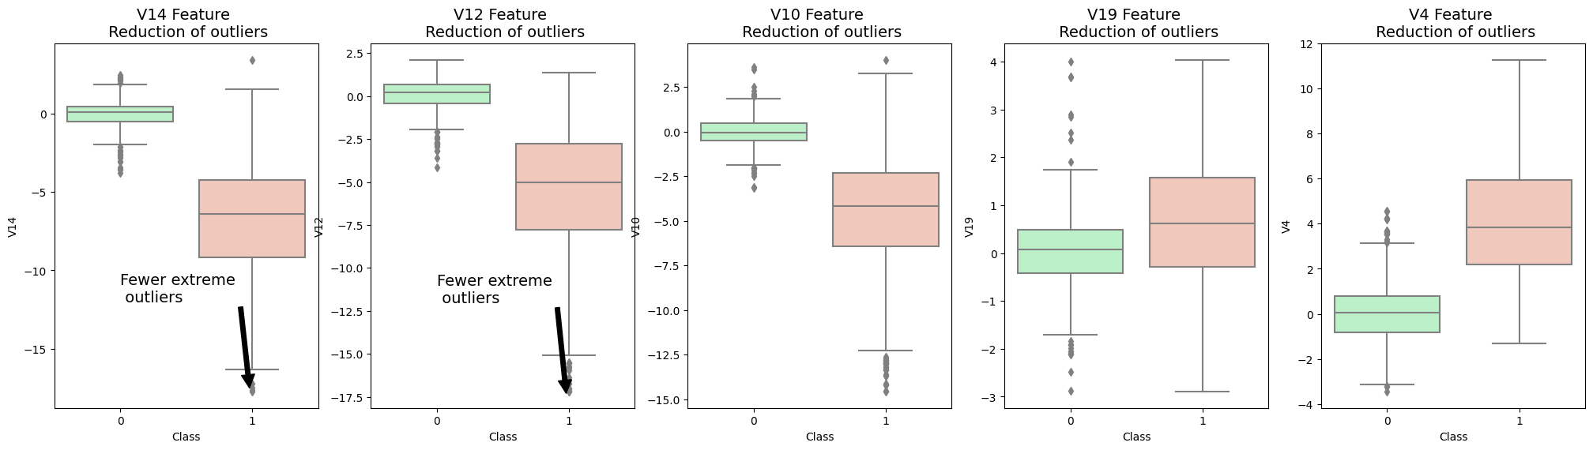
Summary:
We start by visualising distribution of the features, we are going to eliminate some of the outliers. V14 is the only feature that has Gaussian distribution compared to the features V12 and V10.
We create conditional dropping stating that if the “threshold” is exceeded in both extremes, the instances will be removed, and visualize it through boxplot.
After implementing outlier reduction, our accuracy increased by over 3%.

Slide 12
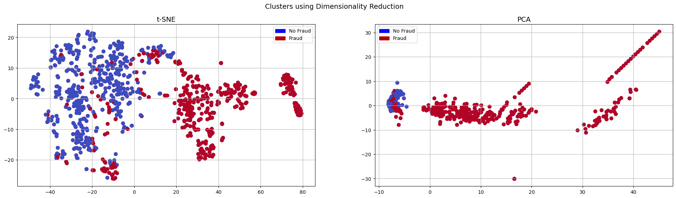
Dimensionality Reduction and Clustering:
Understanding t-SNE (t-distributed Stochastic Neighbour Embedding) is an unsupervised non-linear dimensionality reduction technique for data exploration and visualising high dimensional data. This algorithm allows us to separate data that cannot be separated by a straight line.
Determine the similarity between all points in the data.
Scale the likelihoods to sum up to one.
Matrix of similarity scores.
t-Distributed similarity

Slide 13
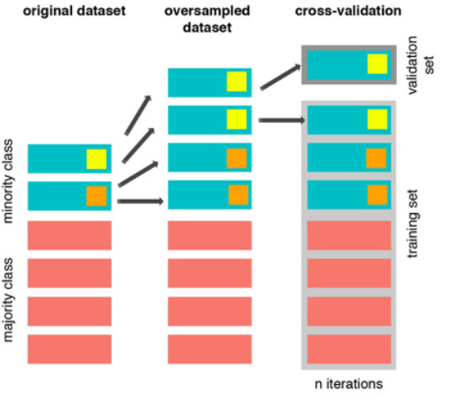
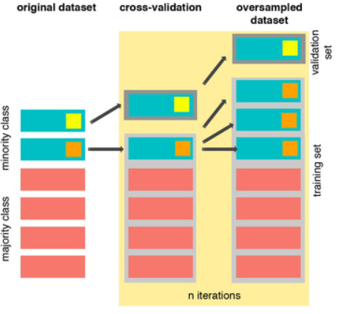
Cross Validation and Overfitting Mistake:
One should always under sample or oversample the data before cross validating because you will be directly influencing the validation set before implementing cross-validation causing a "data leakage" problem. The model should not be tested or validated on synthetic data. In the following section you will see amazing precision and recall scores but in reality our data is overfitting.
As you see above, SMOTE occurs "during" cross validation and not "prior" to the cross validation process. Synthetic data are created only for the training set without affecting the validation set.

Slide 14
Classifiers (Under-sampling):
We are using four different classifiers and decide which classifier will be more effective in detecting fraud transactions. Before that, we have to split our data into training and testing sets.
Accuracy Scores:
LogisticRegression Has a training score of 94.0 % accuracy score
KNeighborsClassifier Has a training score of 93.0 % accuracy score
SVC Has a training score of 93.0 % accuracy score
DecisionTreeClassifier Has a training score of 92.0 % accuracy score
Cross-Validation Scores:
Logistic Regression Cross Validation Score: 93.68%
Knears Neighbors Cross Validation Score 93.55%
Support Vector Classifier Cross Validation Score 93.55%
DecisionTree Classifier Cross Validation Score 92.34%

Slide 15
NearMiss Undersampling:
Near Miss refers to a collection of under-sampling methods that select examples based on the distance of majority class examples to minority class examples.
NearMiss-1: Majority class examples with minimum average distance to three closest minority class examples.
NearMiss-2: Majority class examples with minimum average distance to three furthest minority class examples.
NearMiss-3: Majority class examples with minimum distance to each minority class example.

Slide 16
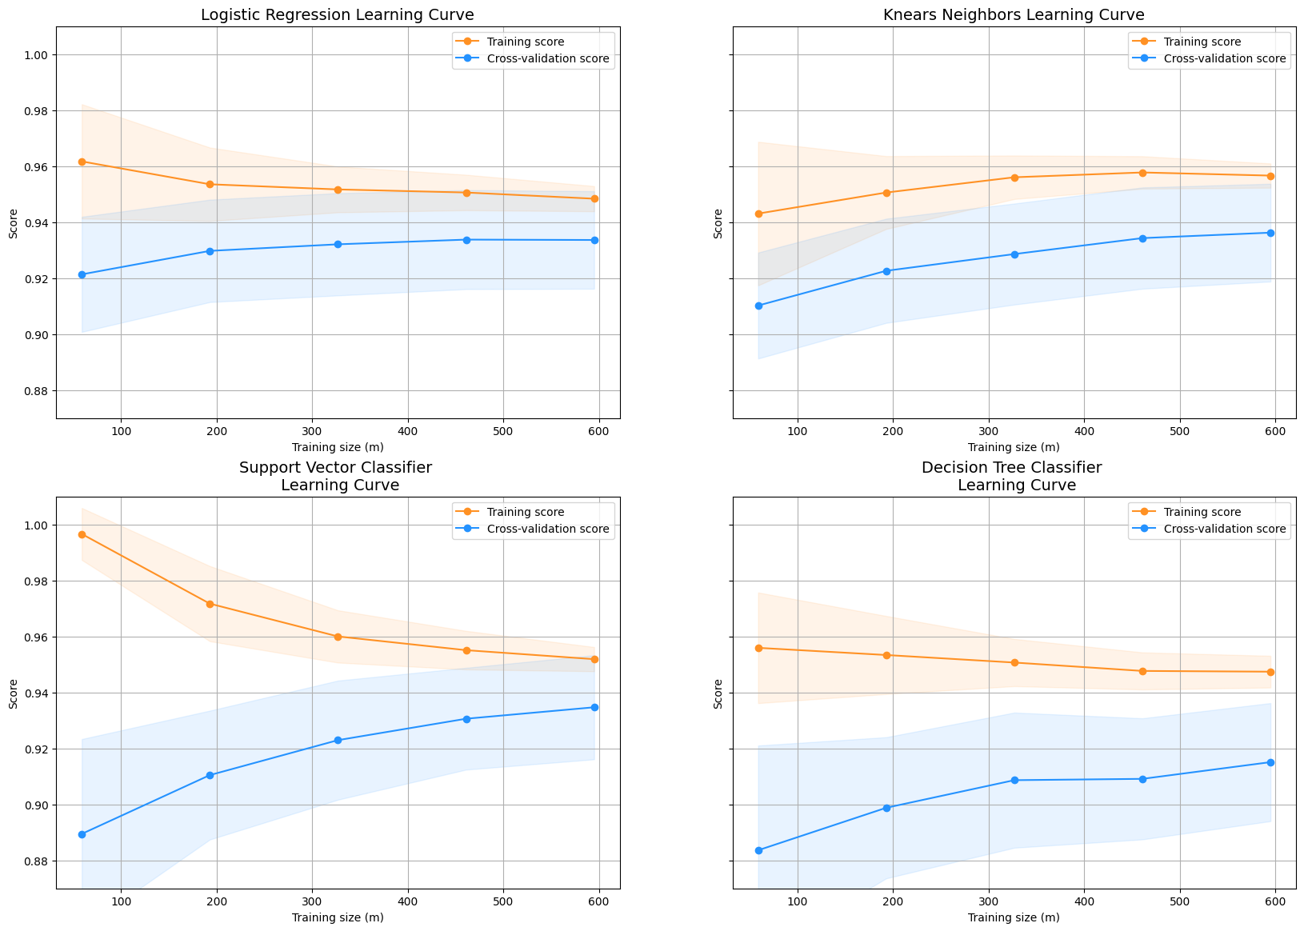
Learning Curve for Classifiers:

Slide 17
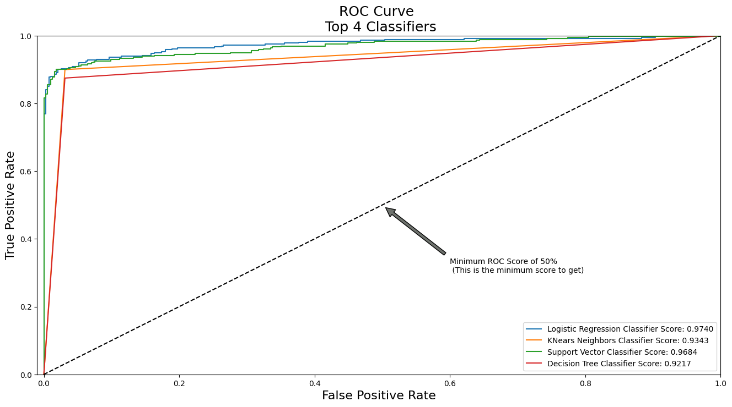
ROC Curves for the Classfiers:
Logistic Regression: 0.9739825633976051
KNears Neighbors: 0.9342763086495677
Support Vector Classifier: 0.9683970625474804
Decision Tree Classifier: 0.9217414897080636
As we can see from the graph and metrics, Logistic Regression appears it me more accurate that the other three in most cases.
Notes:
The wider the gap between the training score and the cross validation score, the more likely your model is overfitting (high variance).
If the score is low in both training and cross-validation sets, this is an indication that our model is underfitting (high bias)

Slide 18
SMOTE – Synthetic Minority Over-Sampling Technique:
It creates new synthetic points in order to have an equal balance of the classes.
Understanding SMOTE:
Solving the Class Imbalance: SMOTE creates synthetic points from the minority class in order to reach an equal balance between the minority and majority class.
Location of the synthetic points: SMOTE picks the distance between the closest neighbours of the minority class, in between these distances it creates synthetic points.
Final Effect: More information is retained since we didn't have to delete any rows unlike in random under-sampling.
Accuracy & Time Trade-off: Although it is likely that SMOTE will be more accurate than random under-sampling, it will take more time to train since no rows are eliminated as previously stated.

Slide 19
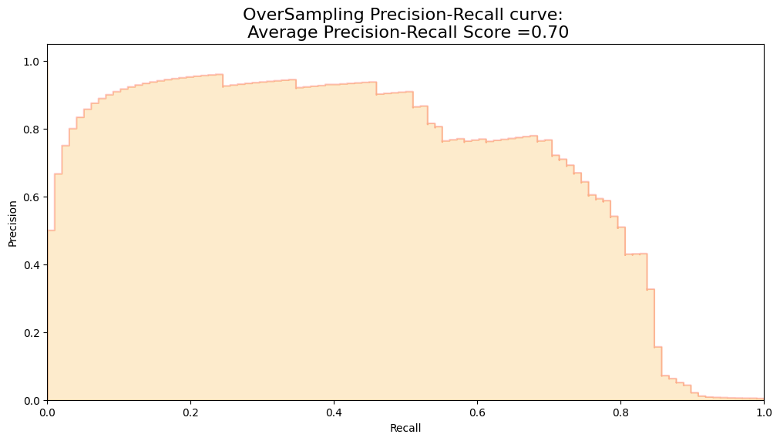
Over-Sampling: Length of X (train): 227846 | Length of y (train): 227846
Length of X (test): 56961 | Length of y (test): 56961
accuracy: 0.970730395067546
precision: 0.06454210498137644
recall: 0.9137617656604998
f1: 0.11947686493828971

Slide 20
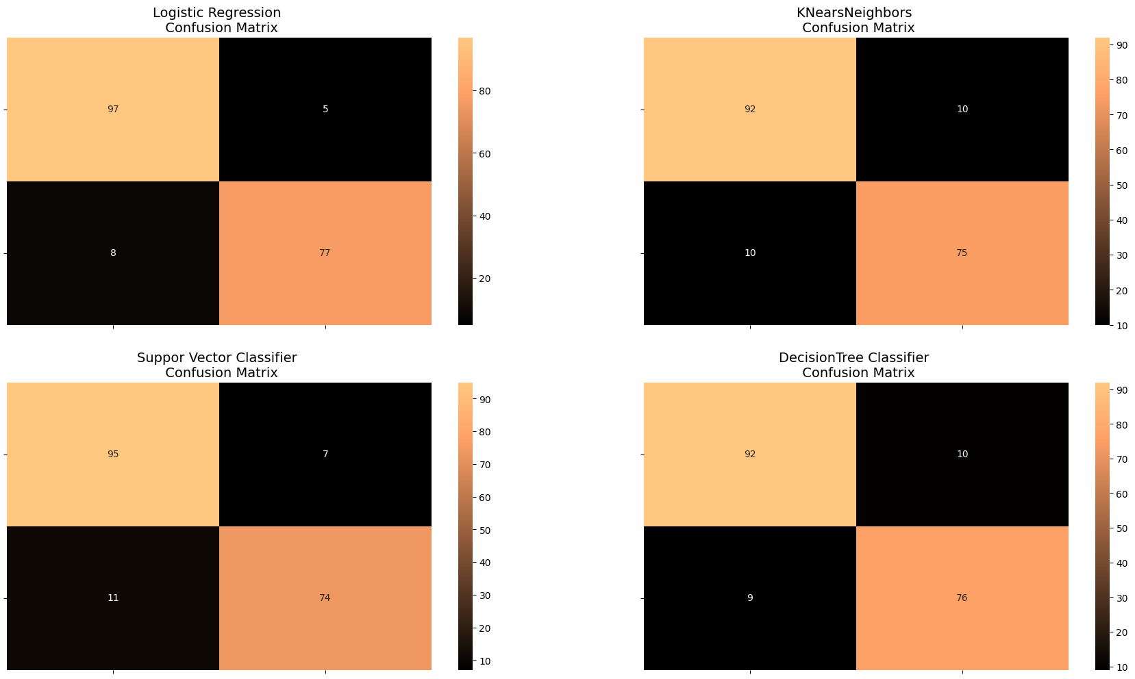

Slide 21
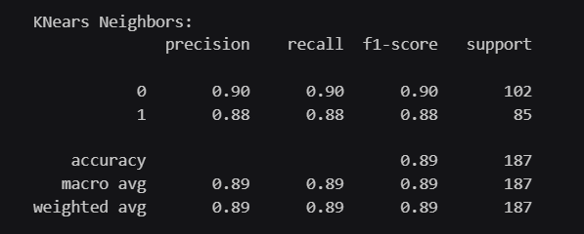
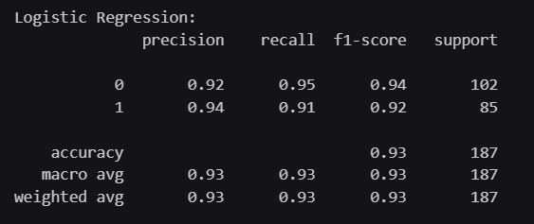
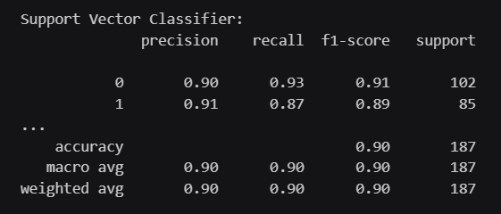
Classification Reports of all the Classifiers:

